Slide 1
Chronic kidney disease survey analysis
Presented by starks :-
Devi eswar kumar damerla
Rufus nemalikanti
Sakthivel.v

Slide 2
Introduction
In simple words we can say that all the toxic and unnecessary materials from the body is collected and thrown out by kidney and excretion system.
There are approximately 1 million cases of Chronic Kidney Disease (CKD) per year in India.
If Chronic Kidney Disease(CKD) is not detected and cured in early stage then patient can show following Symptoms: Blood Pressure, anaemia, week bones, poor nutrition health and nerve damage, Decreased immune response because at advanced stages dangerous levels of fluids, electrolytes, and wastes can build up in your blood and body.

Slide 3
Data collection and analysis
The dataset was obtained from UCI Repository and similar dataset can be found in Kaggle
The dataset contains data of 400 patients with 24 features
We find the correlation of the given features and plot the heat map using the correlation values.
The features with high correlation are chosen and drop one among them since they are linearly dependent.
From the 24 features we select 12 important features that include age, blood pressure etc…

Slide 4


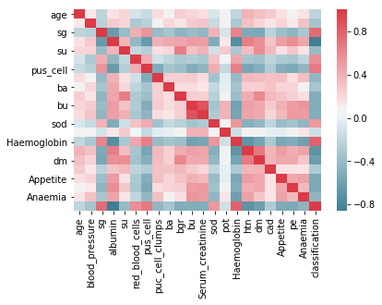
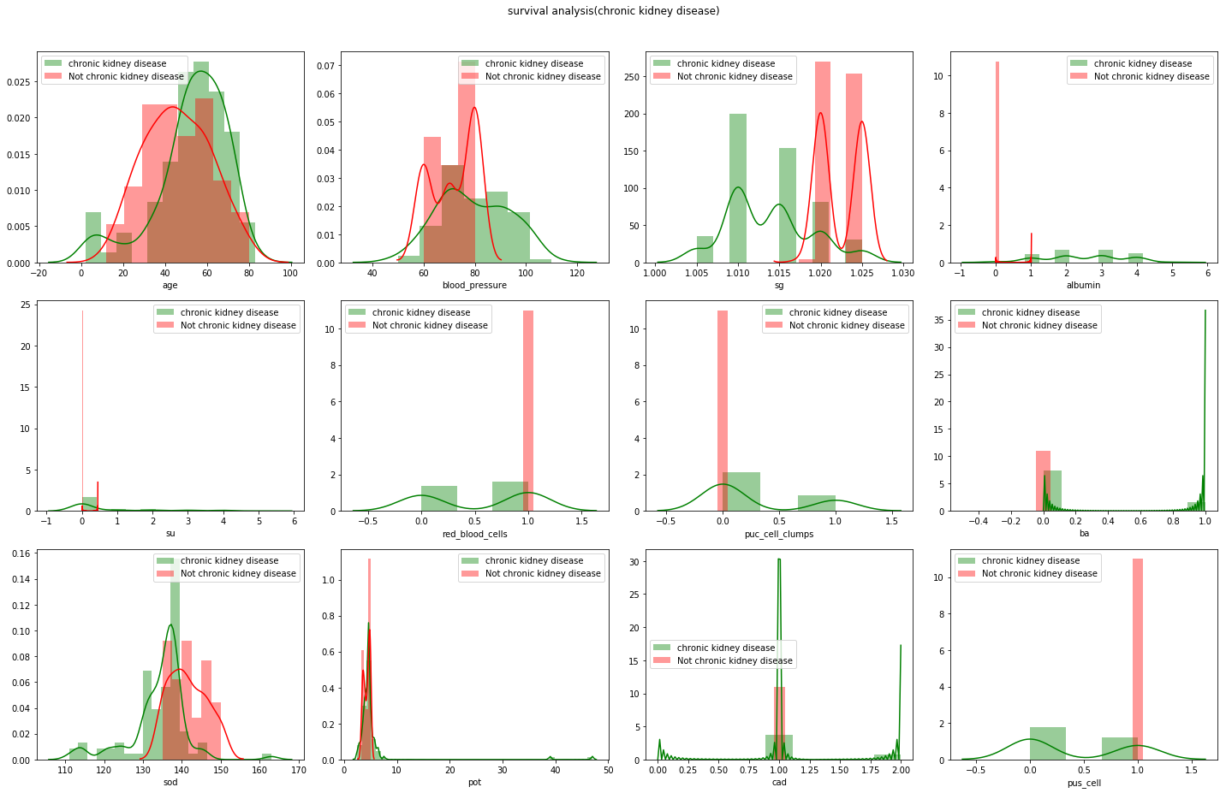
Data visualisation
The first image shows the correlation between the features
The second image shows the distribution plot of the selected features with respect to classification

Slide 5
As we have already selected the features now we split the data for training and testing of the machine learning model
After training the model we used different ML algorithms to find the best model to predict the out come
So we plotted the ROC-AUC graph for different ML algorithms and found the area under the curve of the each graph.
We compared areas of different algorithms using bar graph, from that we selected algorithm with maximum area under the curve which is Naive Baye’s classifier algorithm.

Slide 6
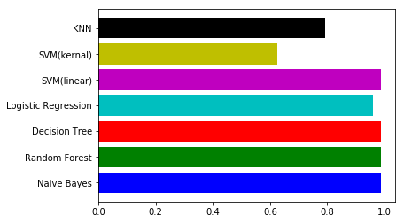
BAR Graph of areas
From this graph we can see that Naïve Bayes has more area under the curve.
And we can also consider it because of its efficiency to perform well in small amount of time with high accuracy score.

Slide 7
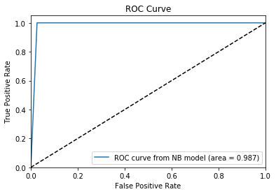
Data modelling using supervised ml techniques
As we have split the data and have trained it we use naïve baye’s algorithm to predict the output (Classification).
The graph shows the ROC-AUC Graph of naïve baye’s

Slide 8
Findings and suggestion
The CONFUSION MATRIX was found to be
The PRECISION was found to be [1.0,0.987].
The RECALL was found to be [0.97363 1.0] .
The F-SCORE [0.9866 0.99009].
The SUPPORT [38,50].
We suggest to use SVM(linear) as a optional algorithm as a replacement of Naïve Bayes, since it has similar accuracy score.
 | Positive | Negative
Positive | 37 | 1
Negative | 0 | 50

Slide 9
Conclusion
We have analysed 12 different attributes related to CKD patients and predicted accuracy for different machine learning algorithms like Logistic Regression, Decision Tree ,Random Forest, k-Nearest Neighbour, Support Vector Machine, Naïve Bayes.
From the results analysis, it is observed that the Naïve Byes algorithms gives the accuracy of 98.86% .
From the results analysis, it is observed that the decision tree algorithms gives the accuracy of 98.8% and Logistic Regression gives accuracy of 96.59%.
To build a machine learning model targeting chronic kidney disease with overall accuracy of 99.99%, will need millions of records with zero missing values.

Slide 10

Thank you
For the patience of hearing us out.
For having us in this amaze group of people.
For giving a nice summer vaction.
This Photo by Unknown Author is licensed under CC BY-NC-ND

